Slide 1
CO2 EMISSION ANALYSIS

Slide 2
The Need for CO2 emission study
Helps us understand and address the issue of climate change by identifying major sources of emissions
Allows For Mitigation strategies
Businesses can use CO2 emissions data to evaluate their environmental impact
Understanding the sources and impacts of CO2 emissions helps raise public awareness about climate change
CO₂ emission data helps nations work together to set global climate goals and create international agreements like the Paris Accord, promoting unified action.
Identifying trends in CO₂ emissions enables governments and communities to prepare for the impacts of climate change (e.g., rising sea levels, extreme weather).

Slide 3
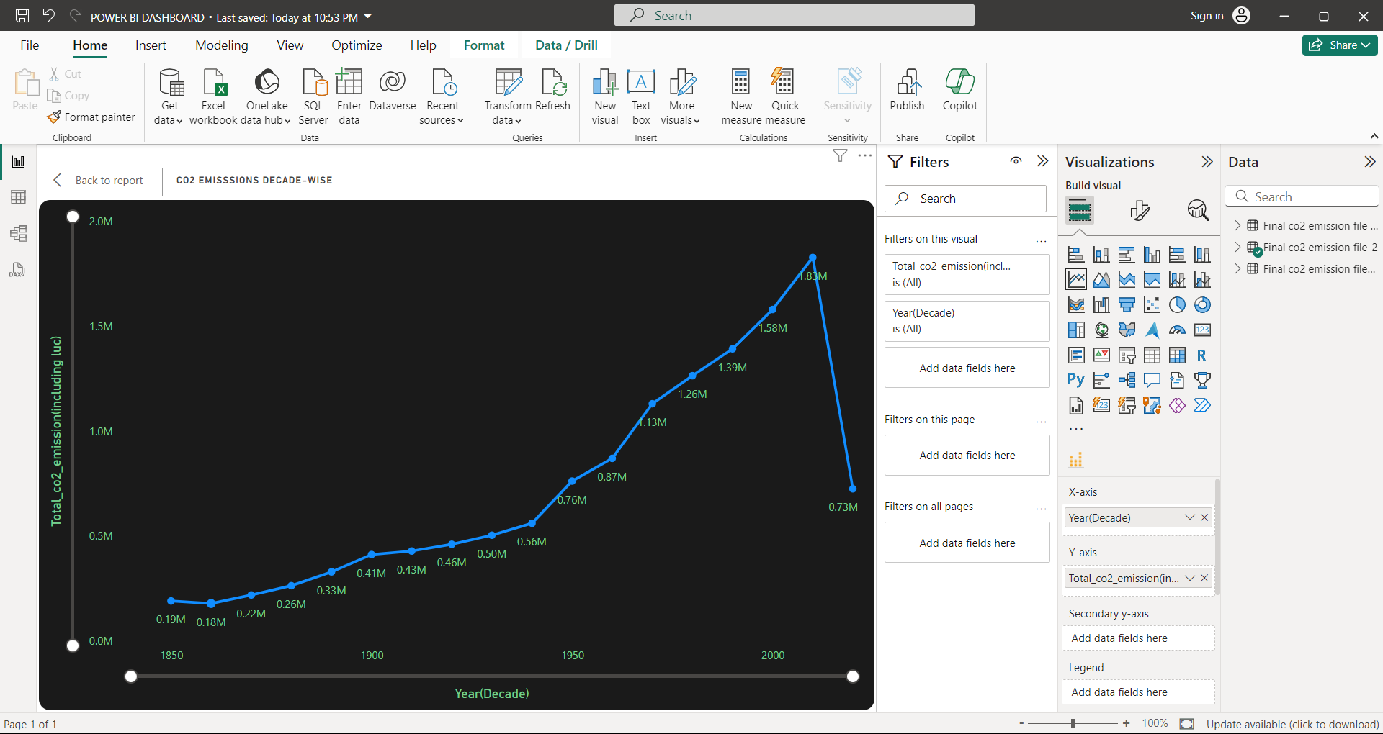
C02 Emission over years
Gradual Increase (1850–1950):
CO₂ emissions remained relatively low during the earlier decades, increasing slowly from 0.19M in 1850 to around 0.56M by 1950.
This reflects the early industrial revolution and gradual expansion of fossil fuel use.
Rapid Growth (1950–2000):
After 1950, emissions grew exponentially, reaching a peak of approximately 1.83M.
This period aligns with post-World War II industrialization, economic growth, and increased reliance on fossil fuels.
Sharp Decline (Post-2000):
A steep drop in CO₂ emissions is visible, falling to 0.73M.
This could signify shifts toward renewable energy, stricter environmental regulations, or economic changes leading to reduced emissions.

Slide 4
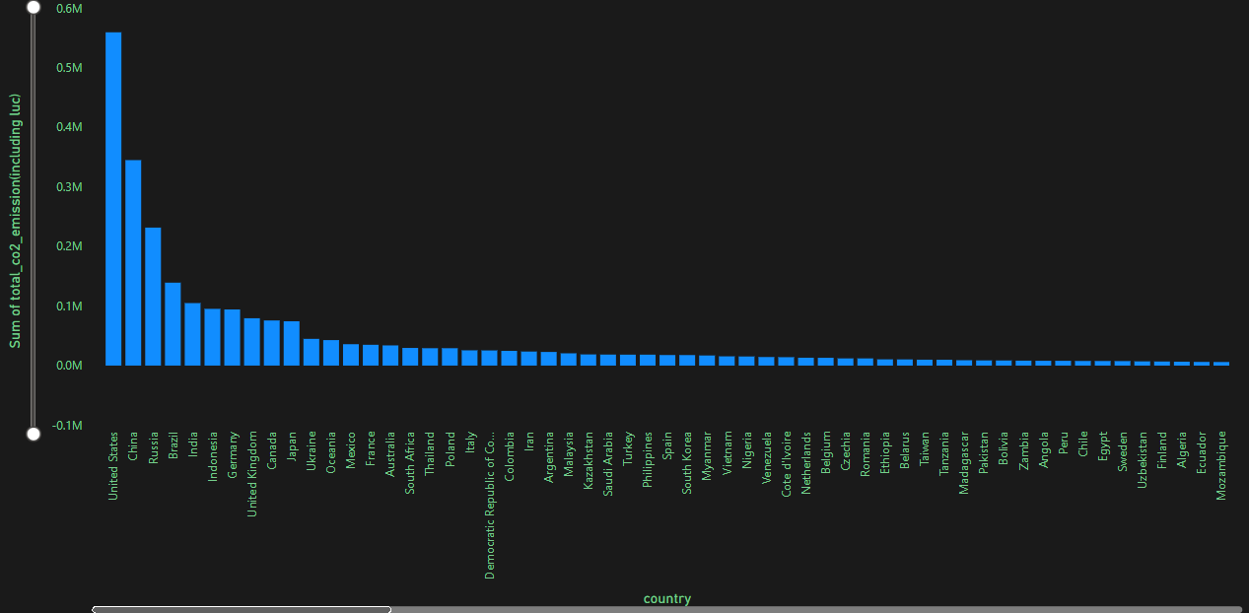
Country Wise Emissions
Top Contributors:
The United States leads with the highest CO₂ emissions, exceeding 0.6 million metric tons.
China, Russia, India, and Brazil follow, showing significant contributions but with a notable gap compared to the United States.
Mid-level Contributors:
Countries like Germany, United Kingdom, Canada, and Japan contribute moderate amounts of emissions, likely due to industrialization and energy usage.
Emissions gradually decrease as we move down the chart.
Lower Emitters:
Towards the end, countries such as Mozambique, Ecuador, and Finland contribute minimal emissions. These may represent less industrialized nations or those with greener energy policies.

Slide 5
Sector Wise C02 Emission

Slide 6
Sector Wise C02 Emission Contd..
Land Use Change CO₂
Largest contributor among sectors, with emissions exceeding 4.5 million tonnes.
Likely includes deforestation, agricultural expansion, and other changes in land use that release stored carbon into the atmosphere.
Coal CO₂ Emissions Second largest source of emissions, slightly below land use change, reflecting the heavy reliance on coal as an energy source.
Indicates its significant role in industrial processes, power generation, and heating.
Oil CO₂ Emissions A significant contributor, with emissions around 3 million tonnes.
Associated with transportation, industrial use, and energy production.
Gas CO₂ Emissions Moderate contributor compared to coal and oil, around 1.5 million tonnes.
Represents emissions from natural gas consumption for heating, electricity, and industrial purposes.
Cement CO₂ Emissions
A smaller, yet notable sector contributing emissions.
Associated with the production of cement, which involves the release of CO₂ during the chemical process.
Flaring CO₂ Minor contributor compared to other sectors, likely related to gas flaring during oil extraction.
Other Industry CO₂ Emissions
Represents miscellaneous industrial activities contributing relatively low CO₂ emissions.

Slide 7
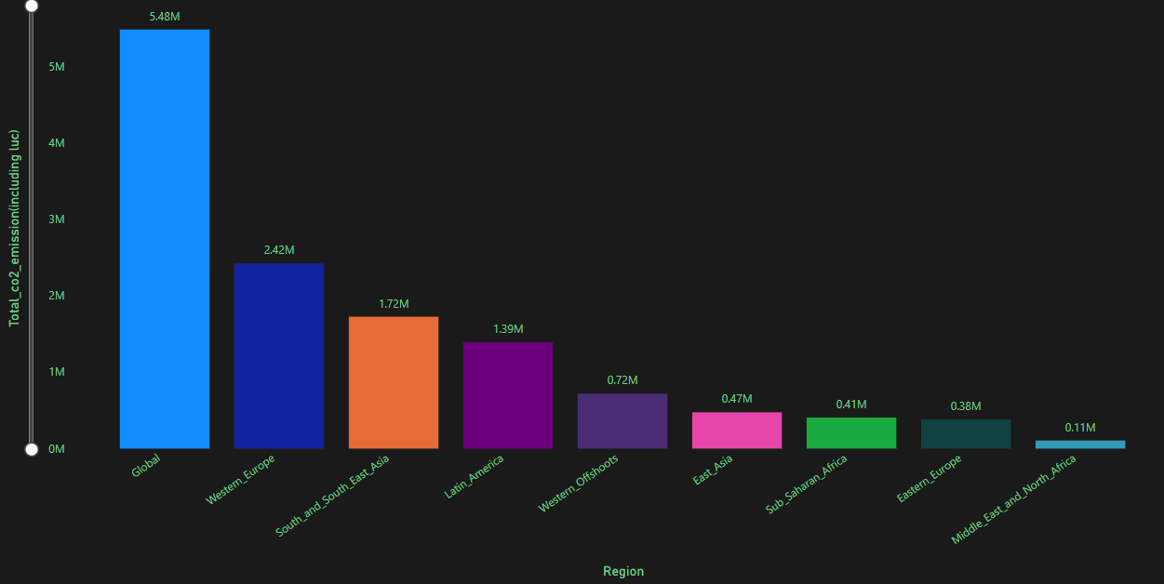
Region Wise Emissions
Western Europe and South/Southeast Asia are major contributors among specific regions.
Middle East and North Africa show the lowest emissions, reflecting lower industrial activity or population size.

Slide 8
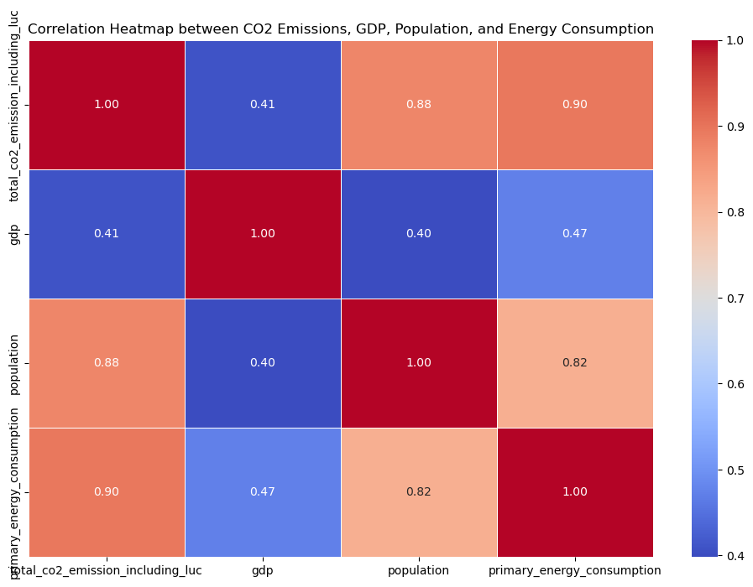
Correlation Between selected variables
1.)Energy use and CO2 emissions are very tightly linked, suggesting that current energy production methods are still heavily carbon-dependent
2.)Population size has a strong influence on both emissions and energy consumption
3.)Surprisingly, GDP (economic output) has much weaker connections with emissions, energy use, and population, suggesting that economic development doesn't necessarily mean proportionally higher emissions or energy use

Slide 9
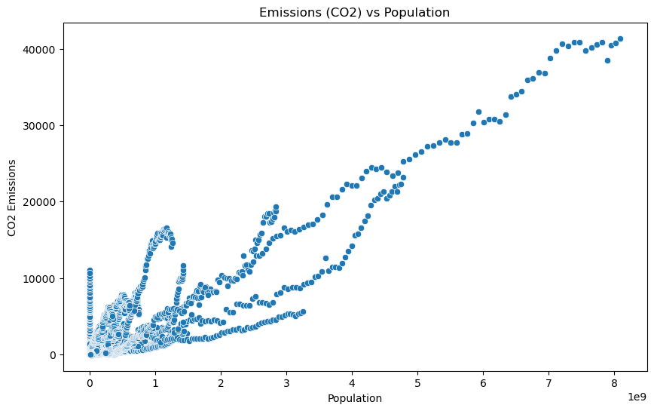
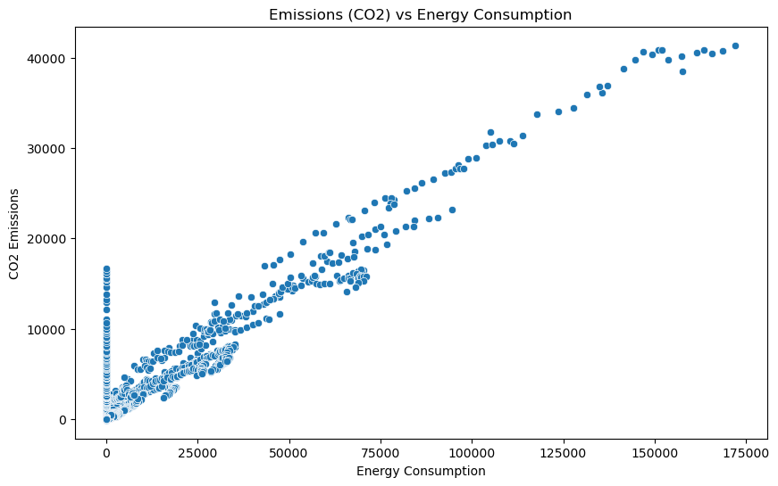
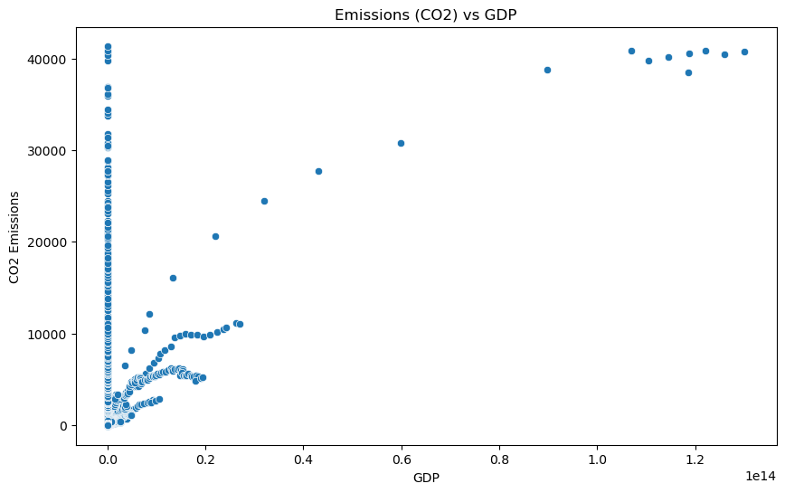
Correlation Between selected variables contd..

Slide 10
Correlation Between selected variables contd..
Direct Link: These graphs shows a much clearer connection between energy use and pollution (CO2) - when countries use more energy, they generally make more pollution. The relationship looks quite straight and direct.
Strong Pattern: Almost all the dots follow a similar upward line, which tells us that energy use and CO2 emissions are closely tied together.
Consistent Rise: As countries' population & GDP Increases and they use more energy (moving right on the graph), their CO2 emissions almost always go up (moving up on the graph). There aren't many exceptions to this pattern.
Clustering: We can see lots of dots clustered at the lower left because some countries are using less energy and they have small population and lower GDP hence they are emitting less CO2 and some are spread out towards the upper right because countries using lots of energy, having lots of population, greater GDP and producing more CO2.
Very Few Surprises: The neat pattern suggests that it's hard for countries to use lots of energy without producing more CO2, at least based on the data shown here. This might be because many countries still rely heavily on fossil fuels for their energy.
Scattered Pattern: Unlike the energy graph, this one shows a much more scattered relationship. The dots aren't forming such a neat line, which tells us the connection between GDP and CO2 isn't as straightforward.
Non-Linear Relationship: The relationship between population and CO2 emissions is not simply linear. As population increases, the rate of increase in emissions varies significantly across different trajectories.

Slide 11
Data Modelling
We have built LinearRegressor Model to Predict Future CO2 Emissions and this is our evaluation matrix below
Mean Squared Error (MSE): 6.112
Root Mean Squared Error (RMSE): 0.0078
R-squared (R2): 0.9999
Then We have built RandomForestRegressor Model to Predict Future CO2 Emissions per Capita and this is our evaluation matrix below
Mean Squared Error (MSE): 0.0058
Root Mean Squared Error (RMSE): 0.07621
R-squared (R2): 0.9467
Then We have also built ExtraTreesRegressor Model to Predict Future CO2 Emissions per Capita and this is our evaluation matrix below
Mean Squared Error (MSE): 0.00047
Root Mean Squared Error (RMSE): 0.0218
R-squared (R2): 0.9956

Slide 12
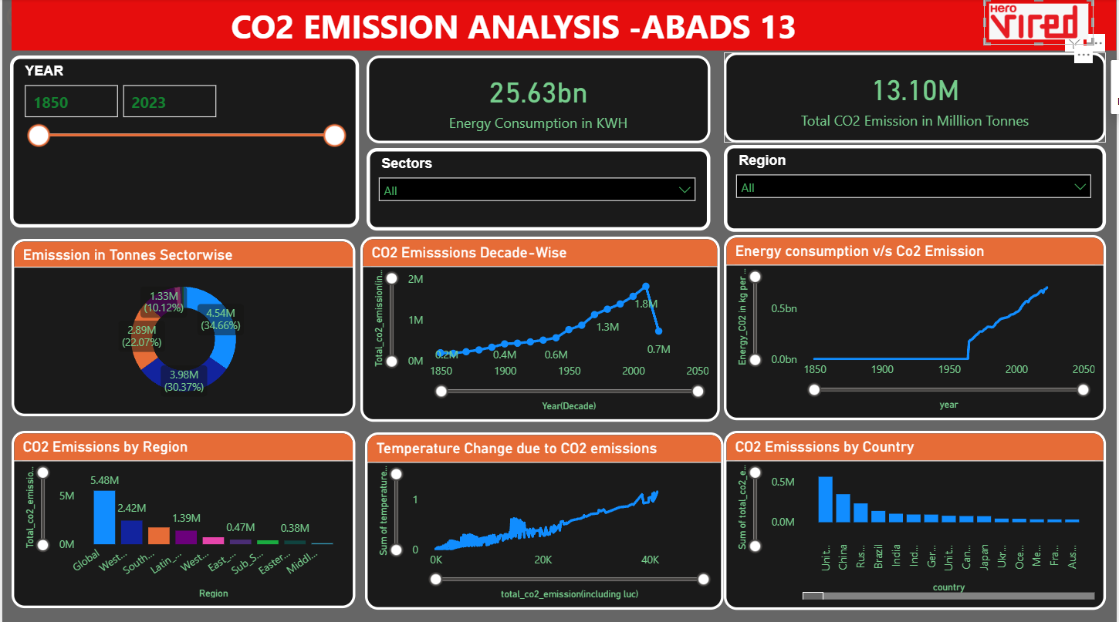
Final Report

Slide 13
Recommendations
Replace fossil fuels with renewable sources like solar, wind, and hydroelectric power to reduce energy-related emissions.
Restore degraded forests and plant new trees globally to act as carbon sinks
Introduce carbon taxes or cap-and-trade systems to incentivize emission reductions in industries
Implement carbon capture and storage (CCS) technology in high-emission industries like cement, steel, and chemicals.
Reduce methane emissions by promoting sustainable farming practices and reducing food waste
Strengthen international climate agreements (e.g., Paris Accord) to hold countries accountable.
Share clean energy technologies with developing nations to reduce emissions worldwide.
Raise awareness about energy conservation (e.g., turning off appliances when not in use).
Invest in technologies to capture flared gas and use it for power generation, industrial applications, or converting it into liquefied natural gas (LNG).
Replace traditional clinker (main CO₂ source in cement) with alternatives like fly ash, slag, or calcined clay to reduce process emissions
Capture CO₂ from industrial processes and inject it into oil reservoirs for Enhanced Oil Recovery (EOR).
Integrate CCS (Carbon Capture and Storage) technologies in cement production to capture CO₂ emissions from kilns and store them underground or use them in industrial processes.

Slide 14
Extra Notes
We could not do the prediction of Sector wise CO2 emission and We couldn't’ do the prediction of Temperature change due to CO2 emission as we lacked the relevant data.
THANK YOU

